Slide 1
Dump Service Proposal
December 2019
Notes:
<number>

Slide 2
Agenda – Dump Service
Dump Overview
Dump Service Requirements
Types of Dump
Dump Offload Flow
Proposed Data Model
Operations on Dump
Background & References
Notes:
<number>

Slide 3
Dump Overview
Dump is the debug data collected at any point of time from the system and is stored in a file
The dump data may consist of application core, network configuration, system inventory configuration, journal log, etc
The dump data is used to troubleshoot the problems that occurred in the system

Slide 4
Dump Service Requirements
Currently, Redfish doesn't have schema for operations on debug data​ (dump).
Requirements:
Defining a common interface for all type of dumps
Support listing of dumps
Support dump creation for all supported targets (BMC, HOST)
Support dump offload for all type of dumps
Support dump deletion
User cannot update the dump (PATCH operation would not be supported)

Slide 5
How the dump is created?
Any critical software or hardware failure may generate the dump
User can generate dump at any point of time
Dump service should provide an interface for user generated dump

Slide 6
Types of dump
BMC dump: Debug data of a service processor (failure or user trigger)
Host dump: Debug data of various host components (failure or user trigger)

Slide 7
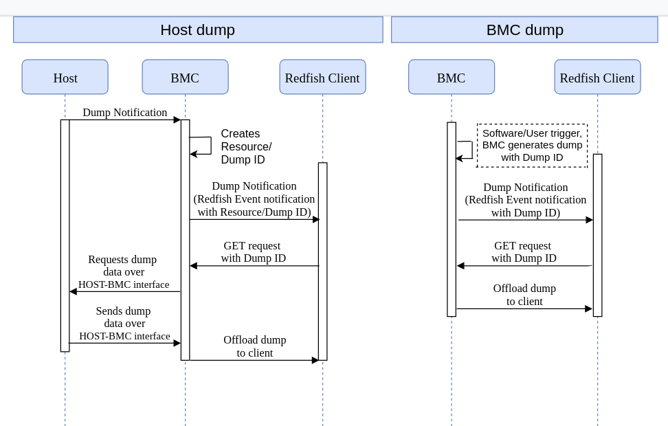
Dump Offload Flow

Slide 8
Proposed Data Model
Notes:
<number>

Slide 9
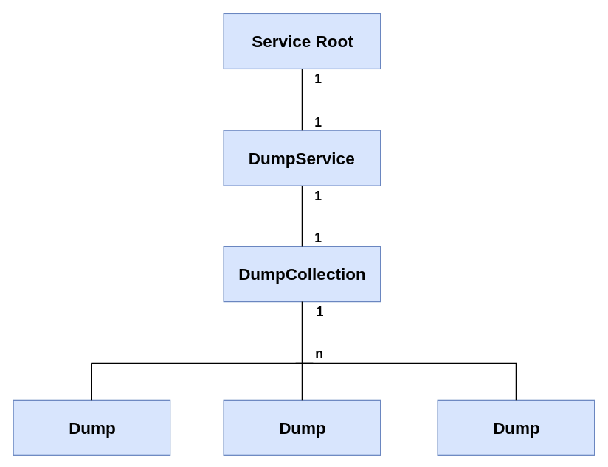
Proposed Data Model
Service Root will have a single instance of DumpService
DumpService will have a single instance of the DumpCollection resource
DumpCollection resource will have multiple dumps

Slide 10
Proposed Data Model
Redfish Resource | Property | Details
DumpService | Dump Override Policy: This policy considers the space constraints and decides on the considerations of new dump when generated | True – Overwrites the oldest dump with the new dump False – Ignores the new dump
 | Dumps | Collection of dumps
Redfish Resource | Action | Details
DumpService | Create dump | Creates the dump
 | Delete all | Delete all dumps

Slide 11
Proposed Data Model
Redfish Resource | Property | Details
DumpCollection | Members | List of dumps
Dump | ID | Unique Identifier
 | Size | Size of the dump
 | Type | BMC/Host dump
 | Timestamp | Time of dump creation
 | Reason | Software failure/Hardware failure/User generated/Kernel panic
Redfish Resource | Action | Details
Dump | Download | Downloads the dump

Slide 12
Proposed Data Model (ServiceRoot) - Mockup
redfish » v1
"@odata.type": "#ServiceRoot.v1_2_0.ServiceRoot",
"Id": "RootService",
"Name": "Root Service",
"RedfishVersion": "1.0.4",
"UUID": "92384634-2938-2342-8820-489239905423",
"DumpService":
{
"@odata.id": "/redfish/v1/DumpService"
},
"@odata.context": "/redfish/v1/$metadata#ServiceRoot.ServiceRoot",
"@odata.id": "/redfish/v1/"

Slide 13
Proposed Data Model (DumpService) - Mockup
redfish » v1 » DumpService
"@odata.type": "#DumpService.DumpService",
"Id": "DumpService",
"Name": "Dump Service",
"Description": "Dump Service",
"Dumps":
{
"@odata.id": "/redfish/v1/DumpService/Dumps"
},
"Actions":
{
"#DumpService.CreateDump": {
"target": "/redfish/v1/DumpService/Actions/DumpService.CreateDump",
"DumpType@Redfish.AllowableValues": [
"Host Dump",
"BMC Dump"
]
},
"#DumpService.DeleteAll": {
"target": "/redfish/v1/DumpService/Actions/DumpService.DeleteAll"
}
},
"@odata.context": "/redfish/v1/$metadata#DumpService.DumpService",
"@odata.id": "/redfish/v1/DumpService"

Slide 14
Proposed Data Model (DumpCollection) - Mockup
redfish » v1 » DumpService » Dumps
"@odata.type": "#DumpCollection.DumpCollection",
"Name": "Dump Collection",
"Members@odata.count": 2,
"Members": [
{
"@odata.id": "/redfish/v1/DumpService/Dumps/1001"
},
{
"@odata.id": "/redfish/v1/DumpService/Dumps/1002"
}
],
"@odata.context": "/redfish/v1/$metadata#DumpCollection.DumpCollection",
"@odata.id": "/redfish/v1/DumpService/Dumps"

Slide 15
Proposed Data Model (Dump) - Mockup
redfish » v1 » DumpService » Dumps » 1001
"@odata.type": "#Dump.v1_1_0.Dump",
"Id": "1001",
"Type": "BMC dump",
"Description": "BMC dump",
"Size": 108944B,
"Timestamp": "2019-11-27 09:41:00",
"Reason": "Service failure",
"Actions":
{
"#Dump.Download": {
"target": "/redfish/v1/DumpService/Dumps/1001/Actions/Download"
}
},
"@odata.context": "/redfish/v1/$metadata#Dump.Dump",
"@odata.id": "/redfish/v1/DumpService/Dumps/1001"

Slide 16
Proposed Data Model (Dump) - Mockup
redfish » v1 » DumpService » Dumps » 1002
"@odata.type": "#Dump.v1_1_0.Dump",
"Id": "1002",
"Type": "Host dump",
"Description": "Host dump",
"Size": 122111B,
"Timestamp": "2019-11-27 19:57:22",
"Reason": "Hardware failure",
"Actions":
{
"#Dump.Download": {
"target": "/redfish/v1/DumpService/Dumps/1002/Actions/Download"
}
},
"@odata.context": "/redfish/v1/$metadata#Dump.Dump",
"@odata.id": "/redfish/v1/DumpService/Dumps/1002"

Slide 17
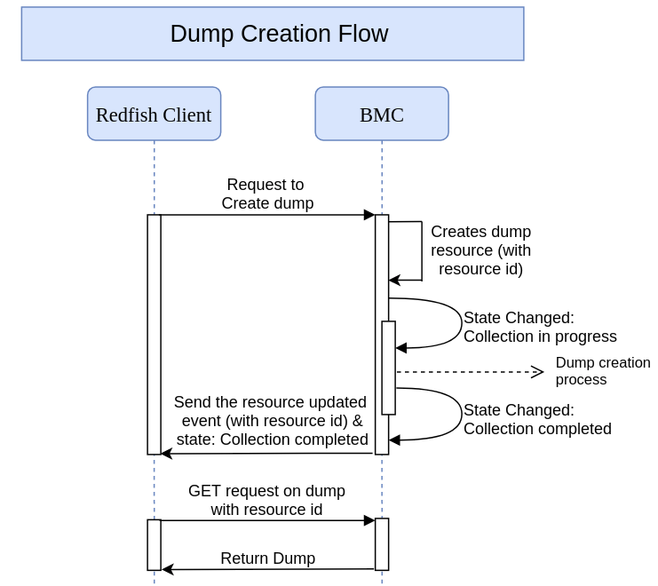
Operations on Dump
Create dump
User Initiated Dump
Approach 1:
POST https://${bmc_ip}/redfish/v1/DumpService/Actions/CreateDump dumpType=BMC/Host
Creates the dump resource(with resource ID) and the state of the dump resource would be “Collection in progress”
Once dump collection is done, the state property will change to "Collection completed" and resource updated event is sent to the connected client.

Slide 18
Operations on Dump
Create dump
User Initiated Dump
Approach 2:
POST https://${bmc_ip}/redfish/v1/DumpService/Actions/CreateDump dumpType=BMC/Host
202 Accepted is sent as response for create dump request and the asynchronous operation will be started which creates a task
Once the task is completed, the state of the task is changed to “Task completed” and redfish resource for the dump is created but unable to find a way that links the “Task completed” to the created redfish dump resource (opening a DMTF issue for the same – Can the “links” property of the task resource be used)

Slide 19
Operations on Dump
Delete dumps
User can delete all the dumps by issuing the following command:
DELETE https://${bmc_ip}/redfish/v1/DumpService/Actions/DeleteAll
This will delete all the dumps
List dumps
Client can get the list of all dumps by issuing the following command:
GET https://${bmc_ip}/redfish/v1/DumpService/Dumps/
This will return the list of dumps
Get dump details
Dump can be read by the following request:
GET https://${bmc_ip}/redfish/v1/DumpService/Dumps/<dumpid>
This will get the dump corresponding to the dumpid

Slide 20
Operations on Dump
Download dump
Client can download a dump file by the following command:
GET https://${bmc_ip}/redfish/v1/DumpService/Dumps/<dumpid>/Actions/Download/
This will download the given dump
Delete dump
Client can delete a dump file in the BMC by issuing the following command:
DELTE https://${bmc_ip}/redfish/v1/DumpService/Dumps/<dumpid>
This will delete the given dump

Slide 21
Background & References
Currently in OpenBMC, there is a repository called phosphor-debug-collector that provides mechanisms to create, offload and delete the dump
Github link: https://github.com/openbmc/phosphor-debug-collector
The following are the existing REST APIs to List, Read, Create, Delete the BMC dumps respectively:
curl -c cjar -b cjar -k -X GET https://<bmc_ip>/xyz/openbmc_project/dump/list
curl -c cjar -b cjar -k -X GET https://<bmc_ip>/download/dump/<dump_id>
curl -c cjar -b cjar -k -H "Content-Type: application/json" -d "{\"data\": []}" -X POST https://<bmc_ip>/xyz/openbmc_project/dump/action/CreateDump
curl -c cjar -b cjar -k -H "Content-Type: application/json" -d "{\"data\": []}" -X POST https://<bmc_ip>/xyz/openbmc_project/dump/entry/5/action/Delete

